Slide 1

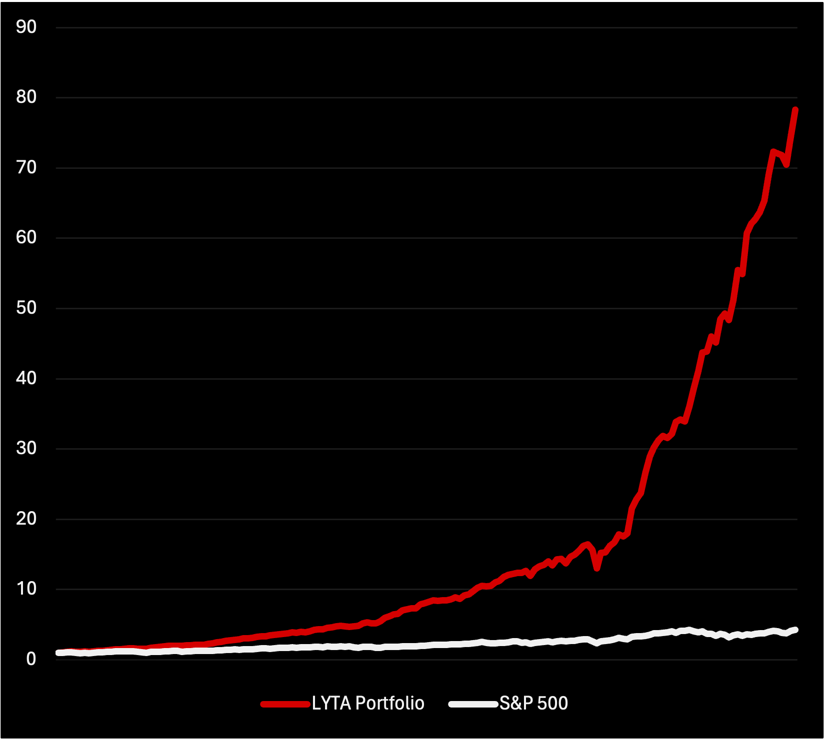

McGill - FIAM Asset Management Hachakton
EXECUTIVE SUMMARY
At LYTA Strategy Analytics, we leverage advanced machine learning and data-driven insights to design optimized investment strategies that consistently outperform traditional market approaches
STRATEGY
MACHINE LEARNING ALGO
PERFORMANCE
Through extensive analysis, we developed an optimal portfolio strategy consisting of long and short positions. delivering superior returns while maintaining a high Sharpe ratio
Leveraging XGBoost for return prediction, our strategy accurately identifies market trends and asset behaviors. The Recursive Feature Elimination for feature selection ensures that only the most relevant variables inform the decision-making process.
Utilizing advanced machine learning, our strategy delivered over 7500% return from 2010 to 2024, far surpassing the S&P 500.
LYTA Strategy Analytics

Slide 2
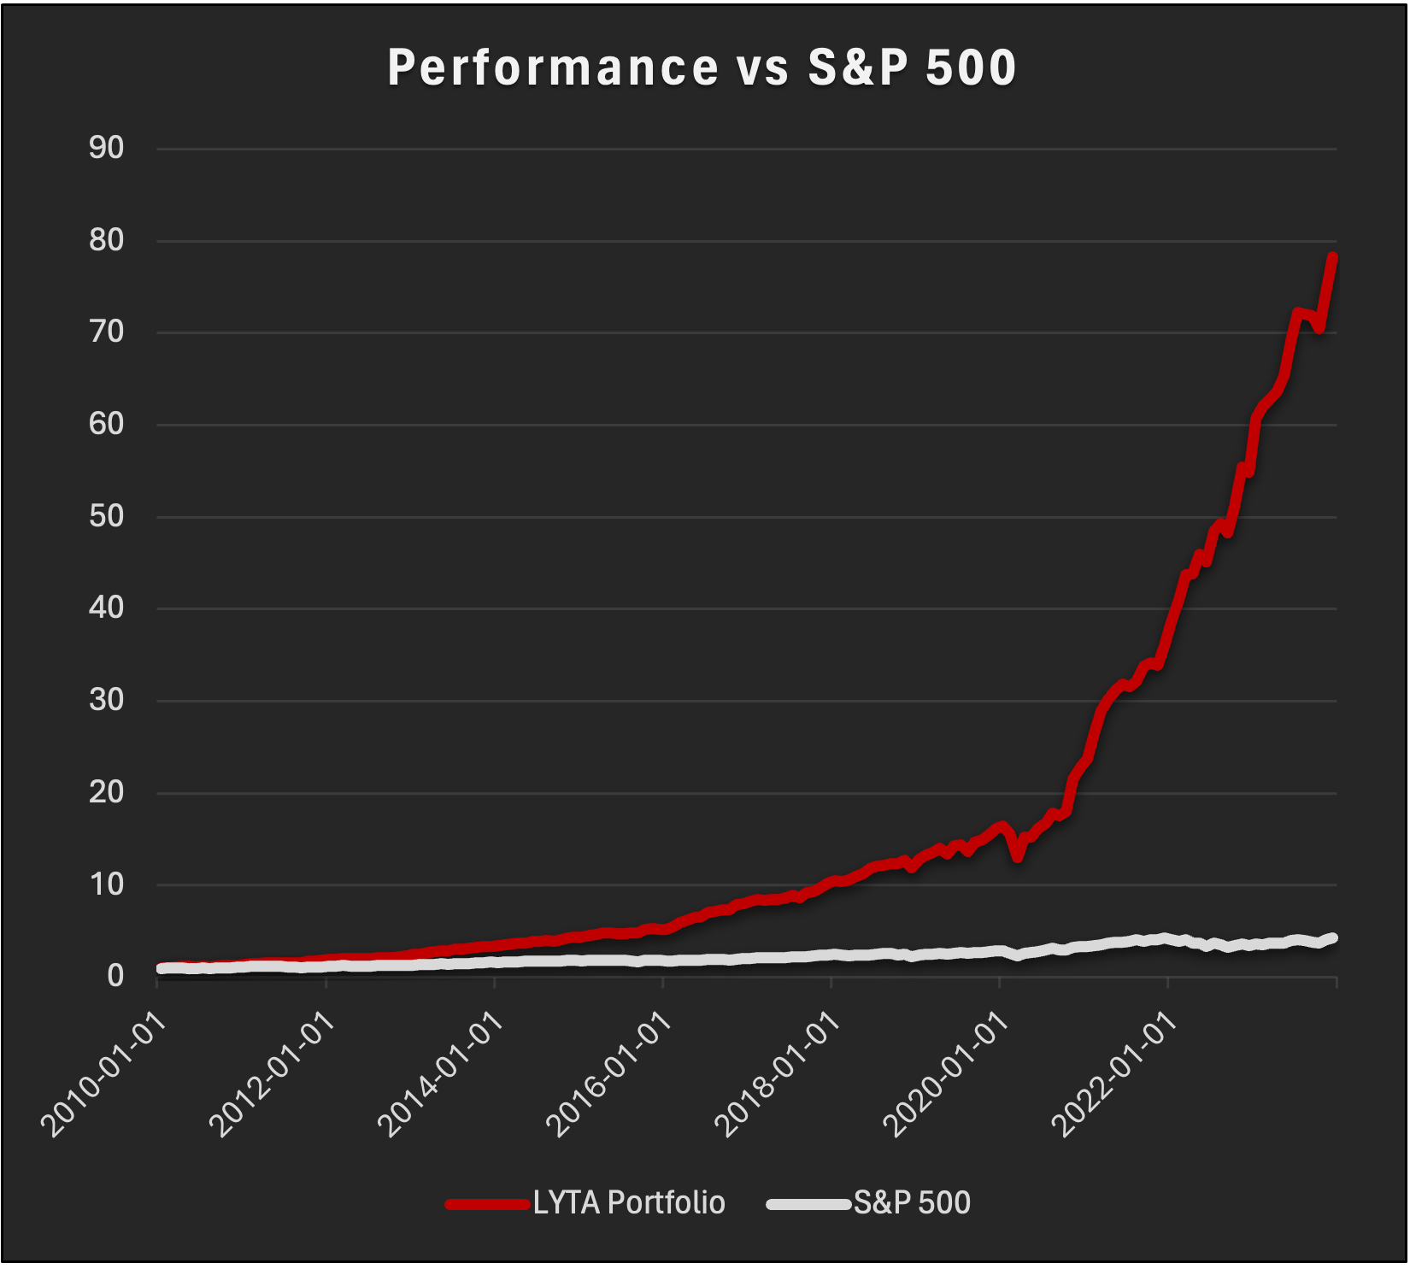
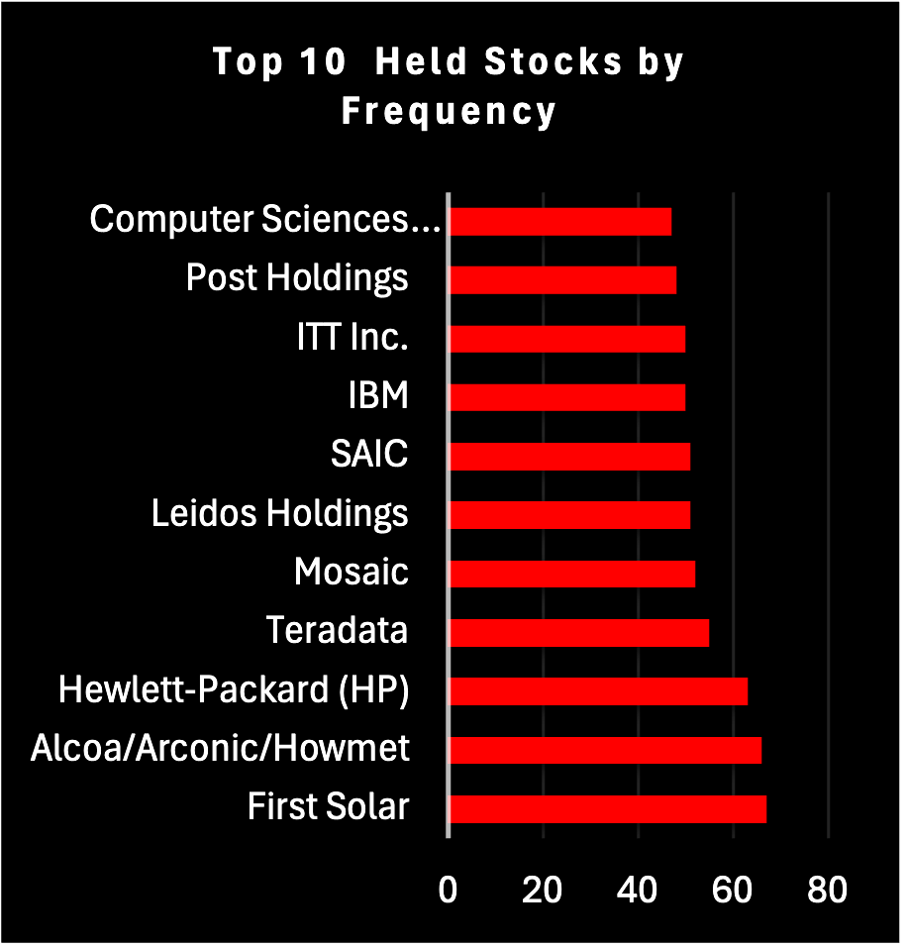
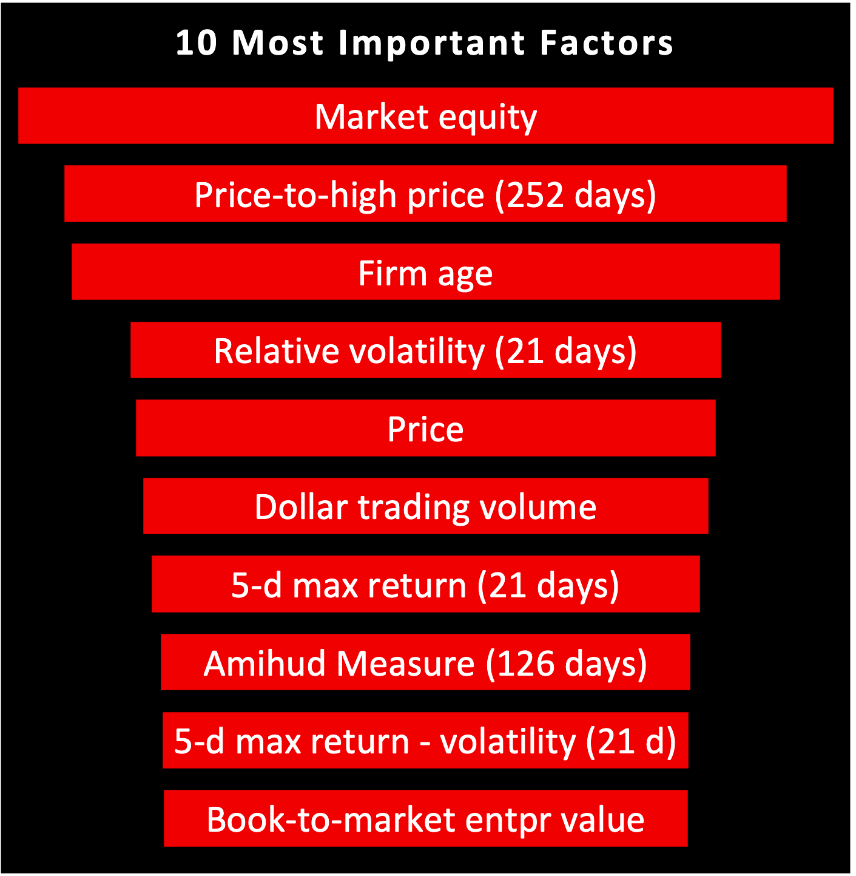
INVESTMENT STRATEGY
Predicted returns from XGBoost guide a mixed long-short strategy, with 70% long and 30% short positions of 51 stocks. This mixed portfolio strategy reiterated every month insure a good balance between return and risk delivering a sharp ratio of 2.466
Performance is based on real returns, showing consistent outperformance over the S&P 500 during the out of sample period. This data-driven approach ensures consistent outperformance in changing market conditions.
LYTA Strategy Analytics

Slide 3
DATA AND METHODOLOGY
Data Preprocessing
The data preprocessing step aims to ensure the integrity and usability of the dataset by cleaning and selecting relevant factors and stocks based on missing values and zero values. Factors with fewer than 30% missing values and less than 20% zero values are retained. Stocks are selected based on the number of available months, keeping those with the most available data and removing stocks that have all missing values for any factor. Missing values in smaller gaps are filled using mean or median imputation, though this method might not fully capture temporal dynamics. Additionally, a ranking and normalization process is applied, where each factor is ranked based on its values to enable comparison between stocks. The normalization adjusts the dataset to ensure that factors contribute equally to the ranking process, preventing scale bias
Feature Selection
By using Robust Scaler for feature scaling, it reduces the impact of outliers, which are common in financial data, ensuring that the model's performance is not skewed by extreme values. The Recursive Feature Elimination (RFE) method helps to automatically identify and retain the most important features, enhancing interpretability and reducing overfitting. The use of 500 estimators and subsampling helps generalize better on unseen data by preventing overfitting and speeding up training without sacrificing too much accuracy. Finally, XGBoost flexibility with parameters like learning rate and tree sampling provides precise control over model performance, making it highly adaptable to various financial prediction tasks. While rule of thumb may suggest to keep from 30-45 out of 145, several tests have been conducted to give out result of 50 features leading to the highest R-squared.
Predictive Model
XGBoost is a highly efficient gradient boosting algorithm that excels at handling non-linear relationships of large complex datasets, using techniques like regularization and parallel processing to reduce overfitting and reduce computational cost. Hyperparameter tuning via GridSearchCV optimizes the model’s performance by testing various parameter combinations, enhancing predictive accuracy. By applying Robust Scaler, it helps the model reduce the impact of outliers, especially in complex financial data and ensuring stability. Also, the model employs time series cross-validation and a time window approach, ensuring realistic training and validation over time. Together, they strengthen XGBoost ability to handle features interaction and imbalances in data, which enhances its suitability and ability to capture the complex pattern in the big financial data. Hyperparameter values are selected based on several test conducted to give the most precise result but still keeping the moderate-to-low computational cost and duration.
LYTA Strategy Analytics

Slide 4

PORTFOLIO PERFORMANCE
LYTA PORTFOLIO
S&P 500
Average Annual Return | 36.54%
Standard Deviation | 0.1313
Alpha (CAPM) | 0.0286
Sharpe Ratio | 2.47
Information Ratio | 2.61
Max Drawdown | -23.02%
Max 1-Month Loss | -16.52%
Turnover (Long) | 35.09%
Turnover (Short) | 49.80%
Average Annual Return | 13.42%
Standard Deviation | 0.157
Alpha (CAPM) | 0
Sharpe Ratio | bellow 0.90
Information Ratio | N/A
Max Drawdown | -18.11%
Max 1-Month Loss | -9.18%
Turnover (Long) | Bellow 5%
Turnover (Short) | N/A
2010 -2024
2010 -2024
The LYTA Portfolio achieves a higher return of 36.54% compared to 13.42% for the S&P 500 but with a larger drawdown of -23.02% versus -18.11%
Despite greater drawdown, the LYTA Portfolio holds a Sharpe ratio of 2.47, significantly outperforming the S&P 500's ratio below 0.90
LYTA Strategy Analytics

Slide 5

Our strategy performed as expected, with a Sharpe ratio of 2.47, indicating a strong risk-adjusted return. The average return of 36.54% significantly outperformed the S&P 500's 13.42%
STRATEGY REVIEW
The model's focus on fundamental signals like market equity, price-to-high, and volatility allowed it to capture both upside potential and downside risk effectively. The use of alternative data and machine learning techniques contributed to the success by identifying patterns.
Profitable Stocks
Macro-Economic Events
Potential Improvements
Top performing positions included companies like First Solar and Hewlett-Packard(HP) resilient in economic downturns.The long positions in companies with consistent revenue growth and low volatility provided stability, while shorting overvalued stocks capitalized on market corrections.
The portfolio benefitted from market recovery post-2008 financial crisis and the stimulus-driven bull market from 2010 to 2023. COVID-19 recovery also provided strong opportunities for long positions in sectors like technology and consumer staples
Enhance Risk Management: Implement dynamic hedging strategies
Feature Engineering: By having more time, we could have implemented more advanced techniques like natural language processing (NLP) to capture sentiment analysis from financial news or earnings reports could improve predictive accuracy
LYTA Strategy Analytics

Slide 6
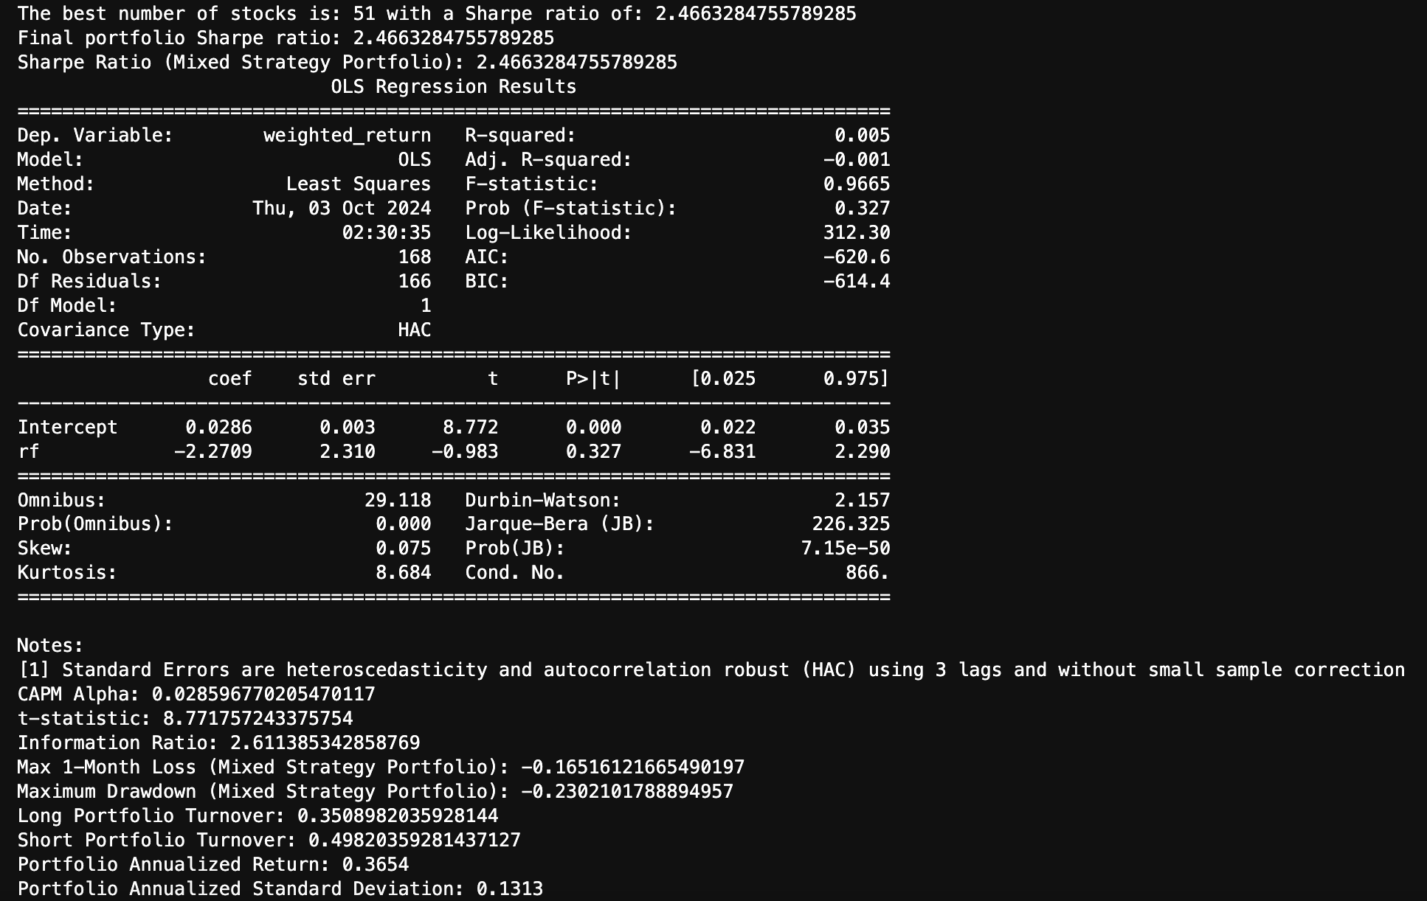
APPENDIX 1
Summary of final strategy (Mixed strategy 70% Long and 30% short)
LYTA Strategy Analytics

Slide 7
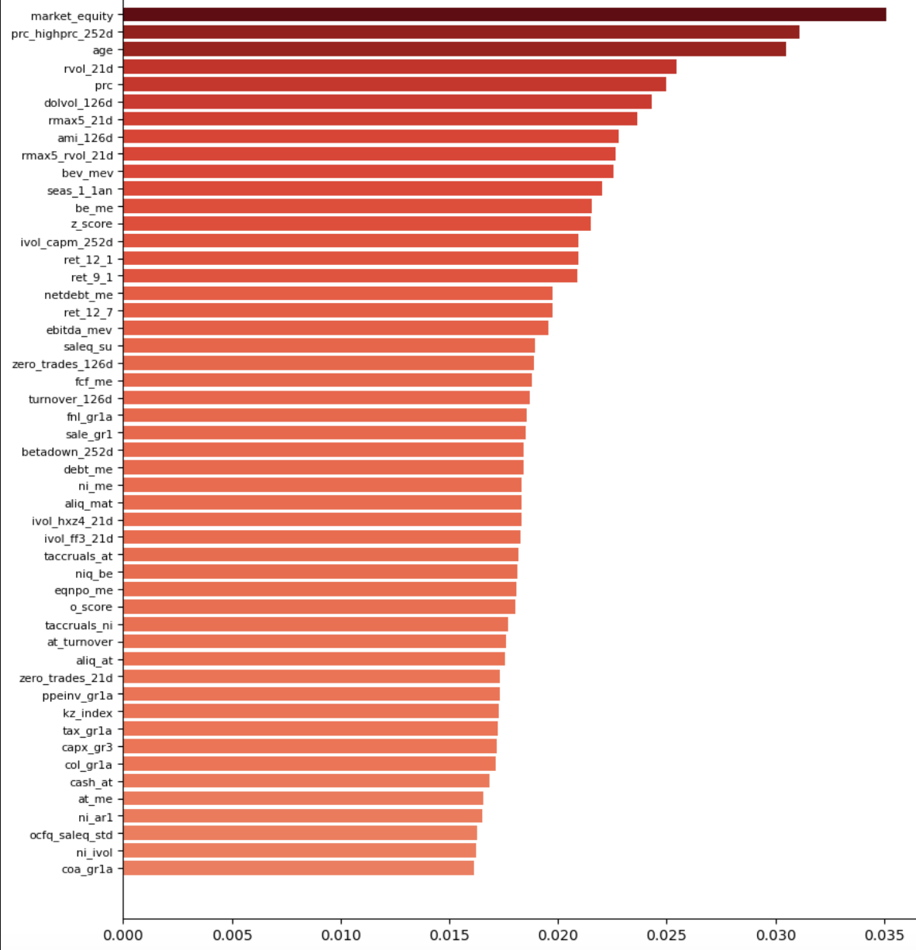
APPENDIX 2
Feature Importance Analysis
LYTA Strategy Analytics

Slide 8
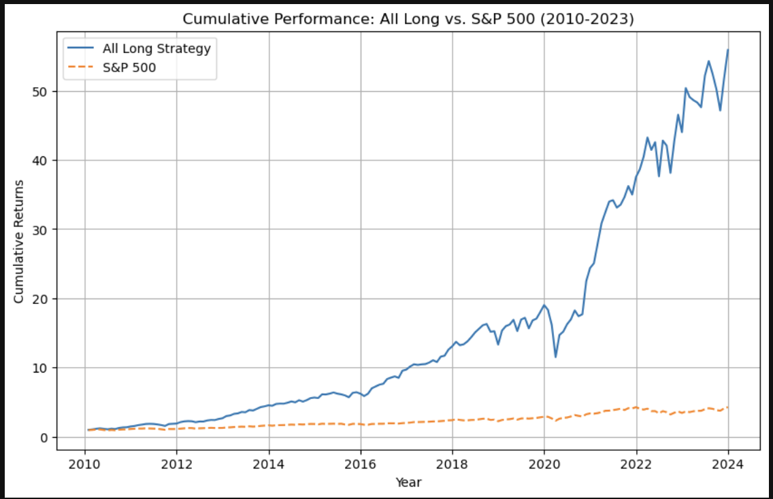
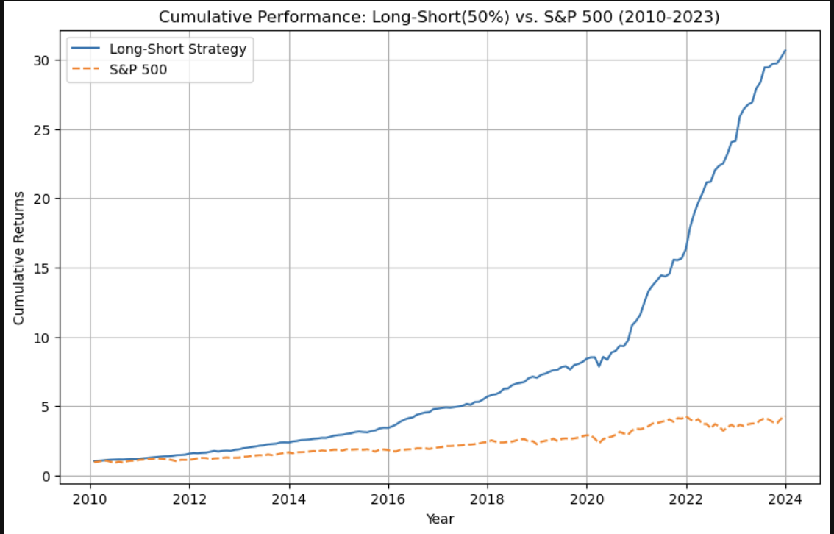
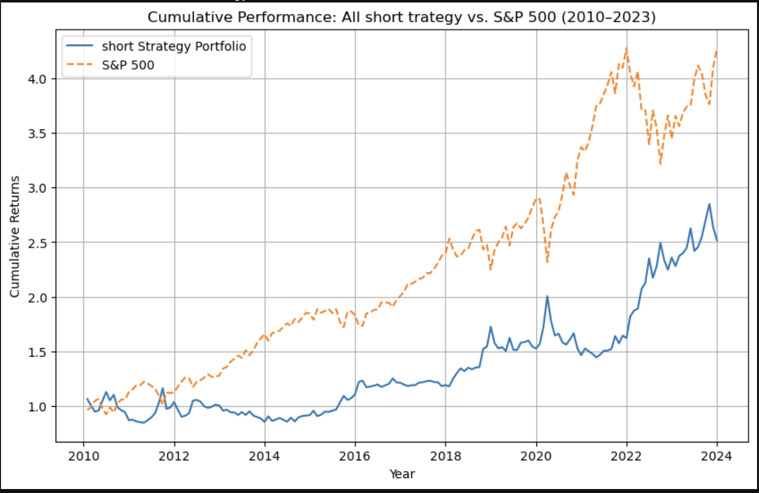
APPENDIX 3
Alternative strategies tested
Sharpe Ratio : 1.34948
Sharpe Ratio : 3.30520
Sharpe Ratio : 0.46555
LYTA Strategy Analytics

Slide 9
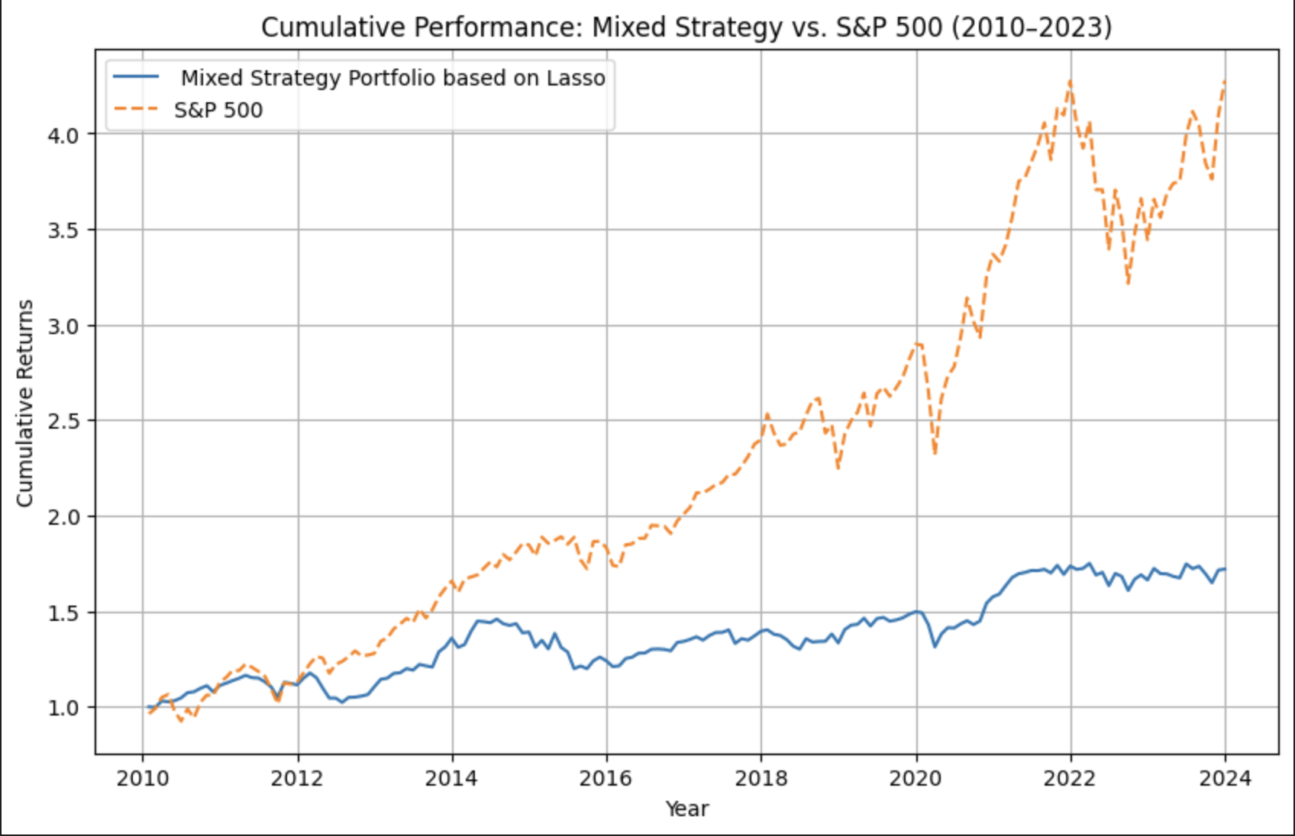
APPENDIX 4
Comparison between Linear model on raw dataset and LYTA model on clean dataset
LYTA Strategy Analytics

